Slide 1
IBM Stock Trader sample for the OpenShift Container Platform
Solid Border:
Required
Dashed Border:
Optional
Red Hat OpenShift Container Platform
loopctl
Looper
IBM
DB2
Redis
IBM Cloud
GET
API Connect
JDBC
Insert, Select,
Update, Delete
Jedis
GET
SET
IEX
Trader (Java)
Portfolio
Stock Quote
GET
GET
SCC
POST/GET
PUT/DELETE
POST
Browser
Broker
Collector
GET
Account
Cloudant
GET, POST
JMS
Put
Watson Tone Analyzer
Legend:
Blue: Open Liberty
Purple: tWAS
Red: Quarkus
Yellow: Node.js
Green: Dependency
Tradr (Node)
IBM
MQ
IBM
ODM
POST
POST
Kafka Send
Notification Service
MDB
onMessage
Notification (Slack)
Functions
Slack
IBM Event Streams
Messaging
POST
POST
POST
Uses an Istio routing rule here
Kafka
Receive
GET
Trade History
GET
Mongo
Notification (Twitter)
POST
Twitter
POST
Twitter4J

Slide 2
The “umbrella” operator for the IBM Stock Trader sample
https://github.com/IBMStockTrader/stocktrader-operator
Wraps the helm chart at https://github.com/IBMStockTrader/stocktrader-helm
Described at https://medium.com/cloud-engagement-hub/the-ibm-stock-trader-operator-part-1-usage-9737a04b6848
Handles installation and configuration of the sample
No “day 2” operations – but does support altering the configuration and pushing that out
All microservices installed by single operator
The application as-a-whole is described by the CR you create from the CRD
No having to install each microservice separately
Can install the sample via a single “oc create -f stocktrader.yaml” command, or via the form UI
Prerequisite services are NOT installed by this operator
Helps configure connections to pre-provisioned prereq services
Might be interesting to explore an “operator of operators” pattern
Could potentially drive the IBM Cloud operator to help with hooking up to resources out in our cloud

Slide 3
MicroProfile features used in IBM Stock Trader
Green means the feature is explicitly used
Yellow means the feature is not explicitly used, but out-of-the-box behavior is implicitly available
Red means no usage of the feature
The non-Liberty microservices, like the Node.js-based Tradr and the tWAS-based Notification-Twitter, are not shown here since there is no MicroProfile available there
Messaging is the only traditional EJB-based microservice. It’s an MDB with no http endpoint
We usually use the fault tolerance features of the OpenShift Service Mesh (Red Hat’s productization of Istio) in lieu of MicroProfile Fault Tolerance
MicroProfile REST Client (with JSON-B) is used for all http/https calls between microservices
Trade History also uses mpReactiveMessaging

Slide 4
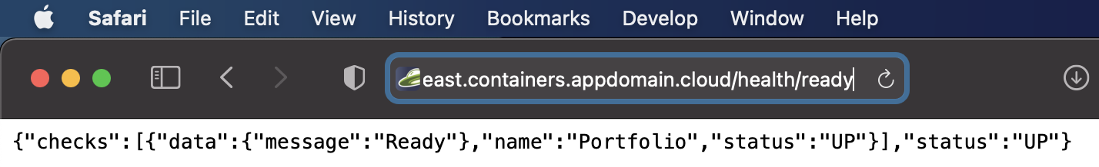
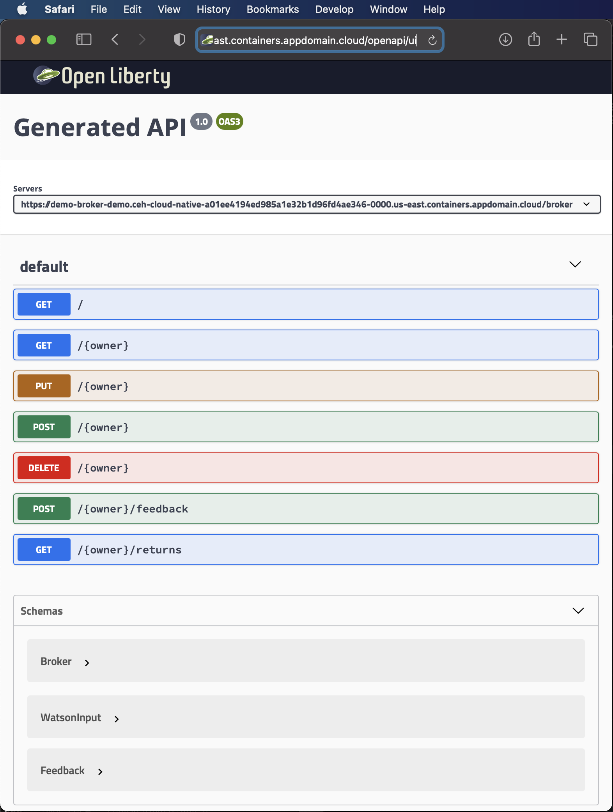
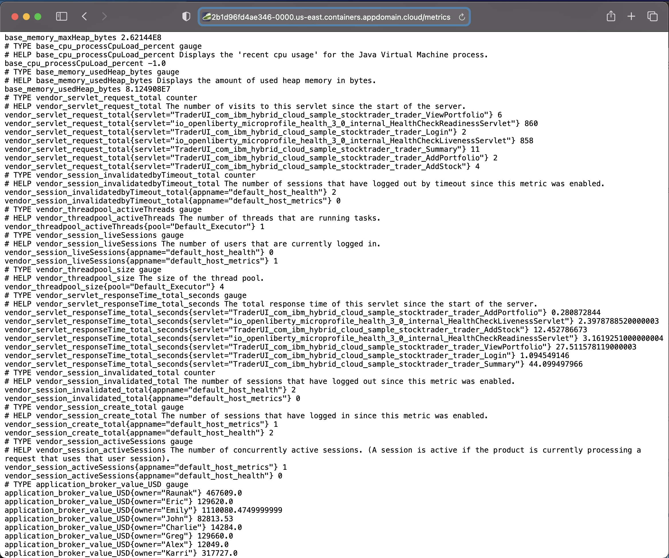
MicroProfile endpoints from IBM Stock Trader
Health:
OpenAPI:
Metrics:

Slide 5
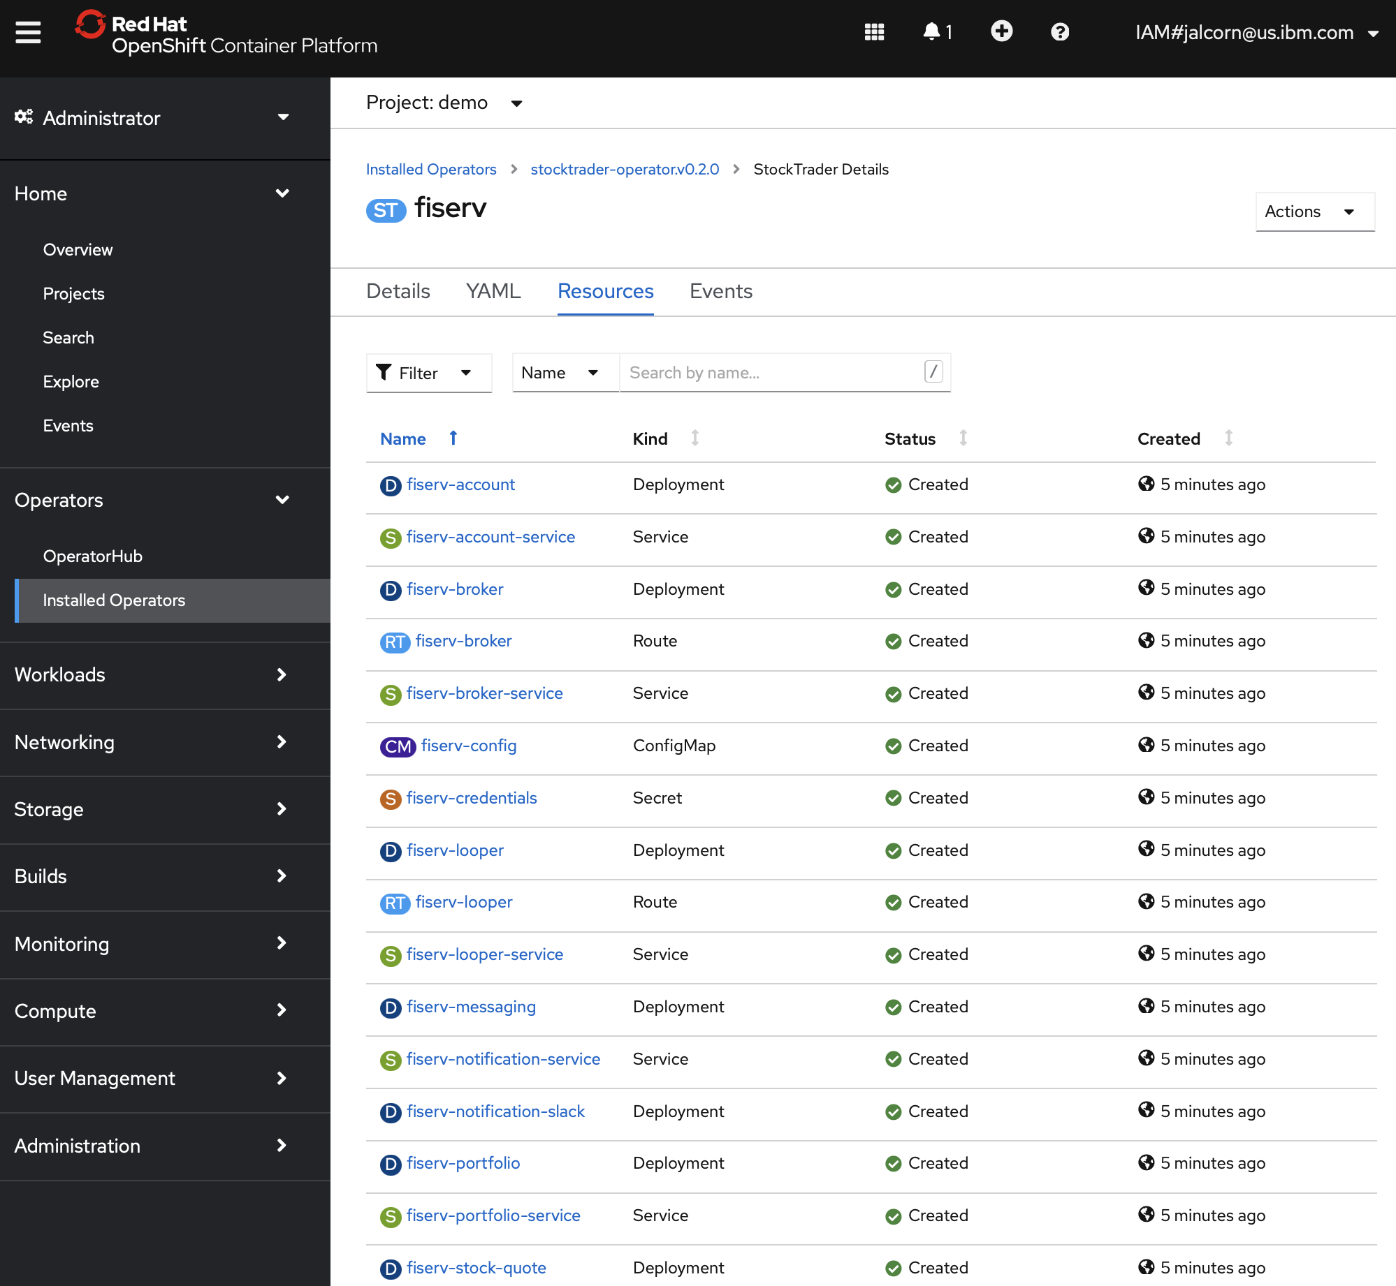
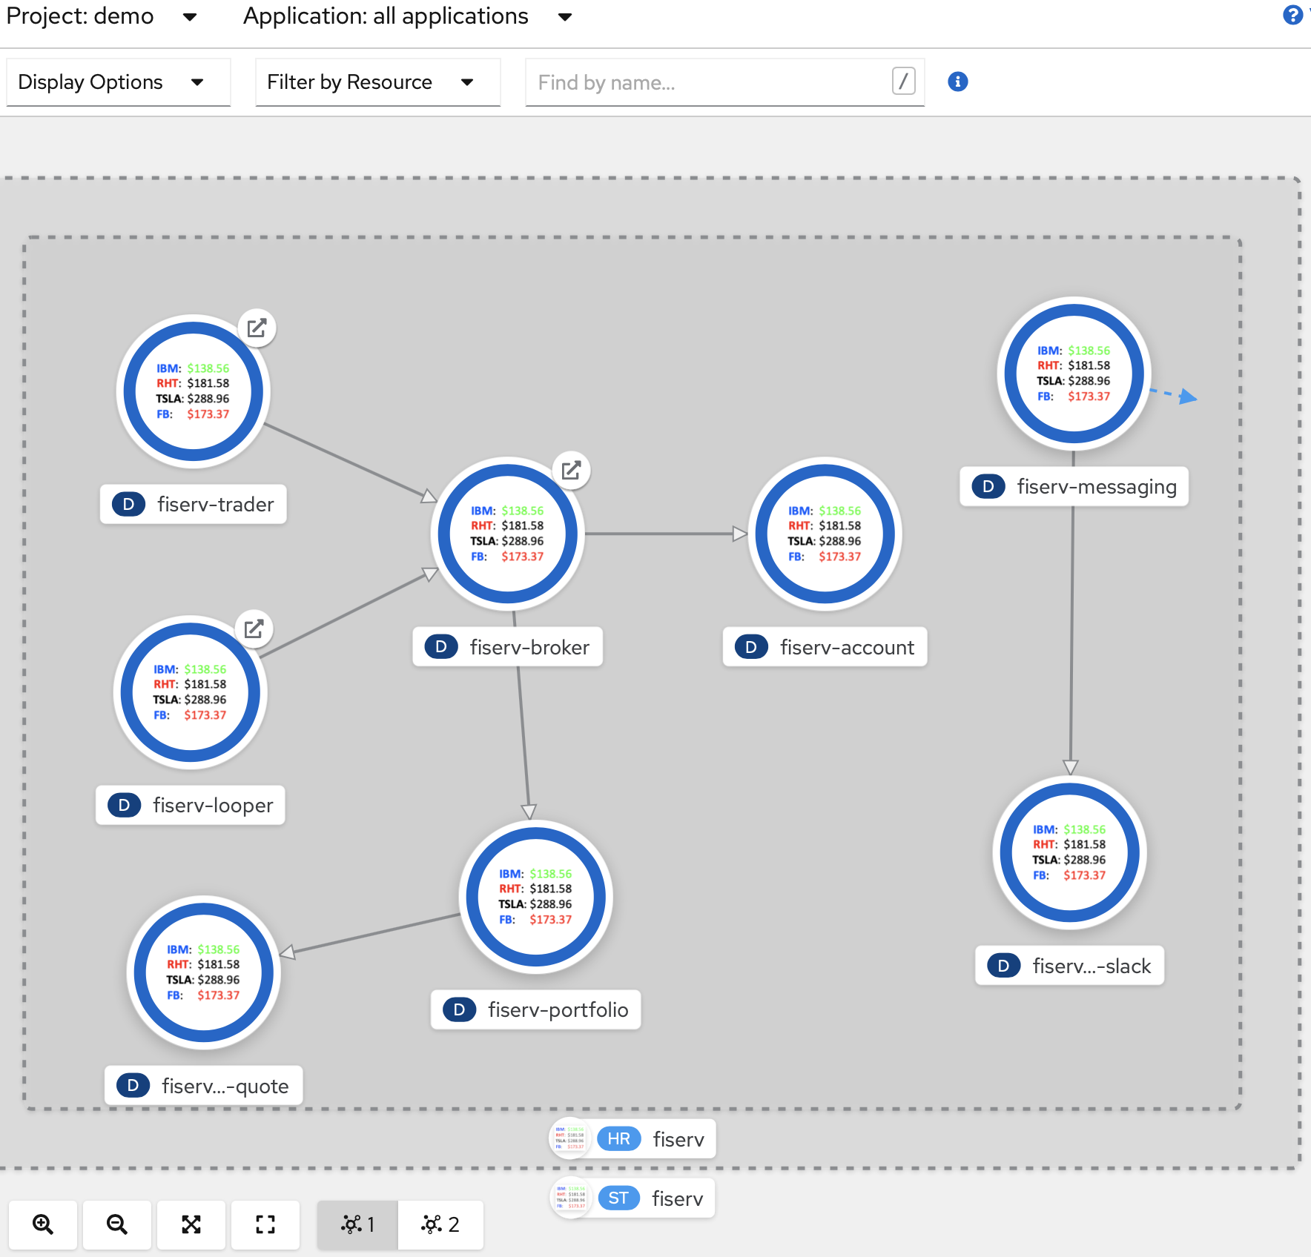
IBM Stock Trader microservices visualized in the OpenShift console

Slide 6




Source for Stock Trader footer image
https://github.com/IBMStockTrader
Source for Stock Trader helm chart/operator icon
IBM: $138.56
RHT: $181.58
TSLA: $288.96
FB: $173.37

